Slide 1
The Bhima Koregaon Case
Siddharth Pandya

Slide 2
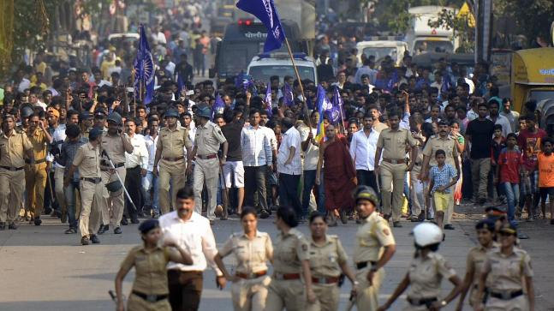
What Is Bhima Koregaon Case
Annual Celebratory gathering on 1st January 2018
The 200th anniversary of the Battle of Bhima Koregaon.
Violent clashes between Dalit and Maratha groups, resulting in the death of at least one person and injuries to several others.

Slide 3
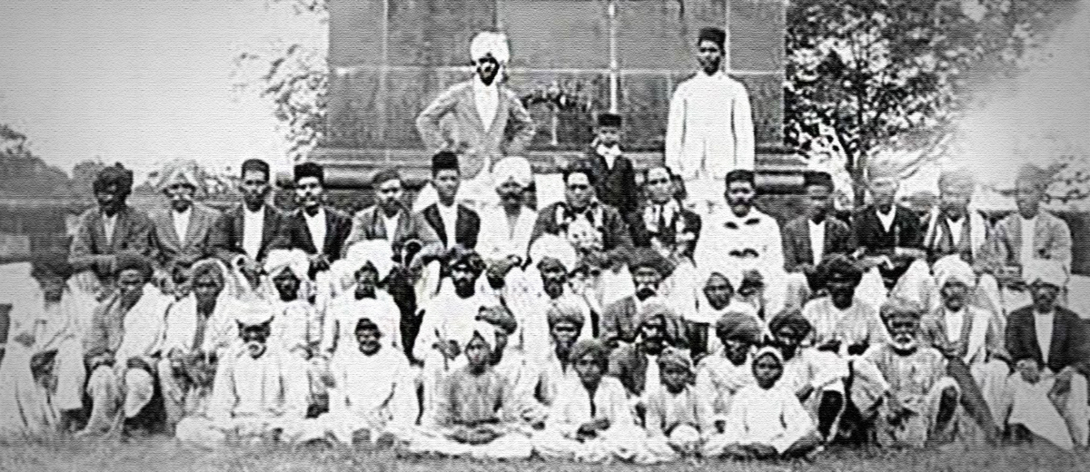
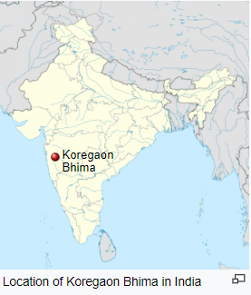
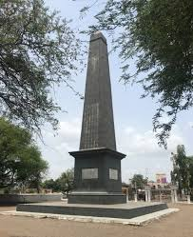
History
Battle of Koregaon:
The 1818 Battle of Koregaon is of importance for Dalits.
It was fought on 1 January 1818 between the British East India Company and the Peshwa faction of the Maratha Confederacy, at Koregaon Bhima.
The battle was part of the Third Anglo Maratha war.
A victory pillar (Vijay Sthamb) was erected in Koregaon by the British, commemorating the dead soldiers.

Slide 4
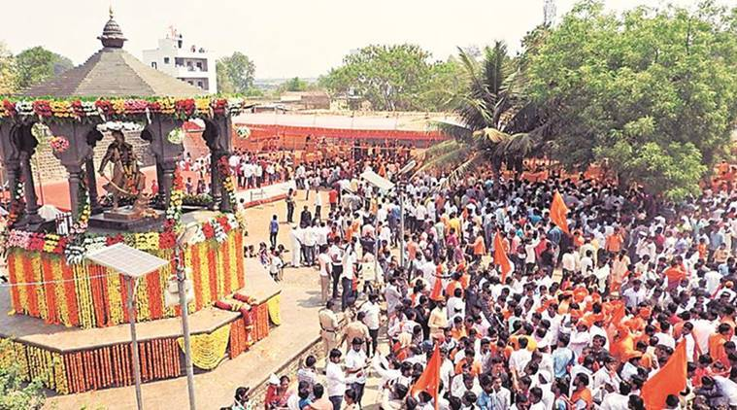
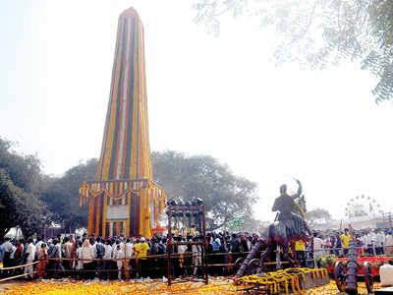
Vadhu Budruk trigger:
Aurangzeb killed Sambhaji Maharaj in 1689.
The memorial for Sambhaji Maharaj was constructed and Govind Mahar’s tomb was constructed in the village after his death,
Marathas refused to accept the role played by Govind Gaikwad and other Mahars in the last rites of Sambhaji Maharaj

Slide 5
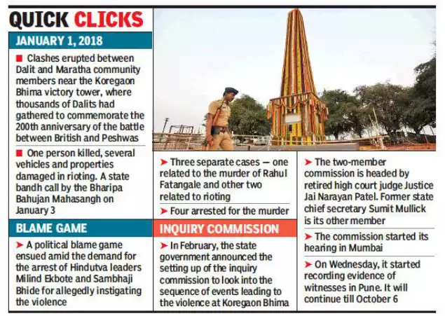
Events
On 1st January 2018 Lakhs of Dalits poured into Bhima Koregaon like every year.
Tension between the communities of Maharas and Marathas this year.
Violence was reported across Pune.
A boy was Killed during the protest.
30 policemen were injured and over 300 people were detained.
Protests were staged all over Maharashtra.

Slide 6
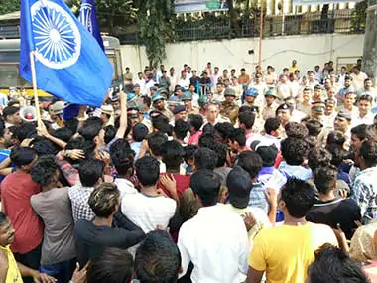
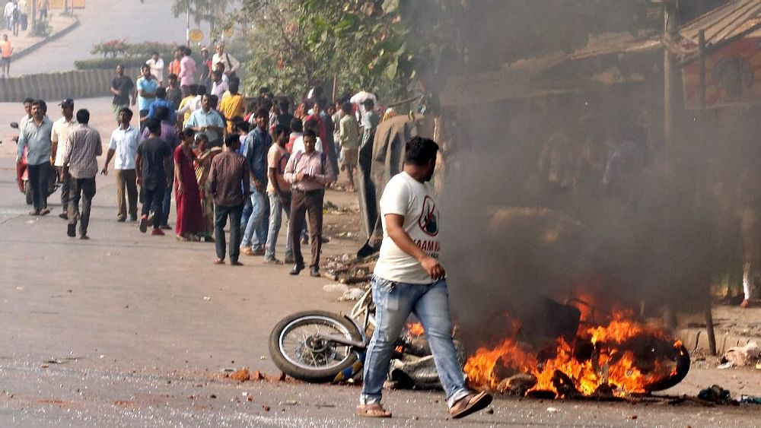
Aftermath
On 2 January 2018, a FIR was filed against Sambhaji Bhide and Milind Ekbote.
In February 2018, the Supreme Court criticised the State government and probe agencies for the slow progress .
On 14 March 2018, the district rural police of Pune arrested Milind Ekbote.
On 22 April 2018, a nineteen-year-old dalit witness was found dead in a well.
In June 2018 Rona Wilson public relation secretary of CRPP under Unlawful Activities (Prevention) Act.
In August 2018 five activists, including Varavara Rao, Arun Ferreira, Sudha Bharadwaj and Gautam Navlakha, were picked up in simultaneous raids across the country.

Slide 7
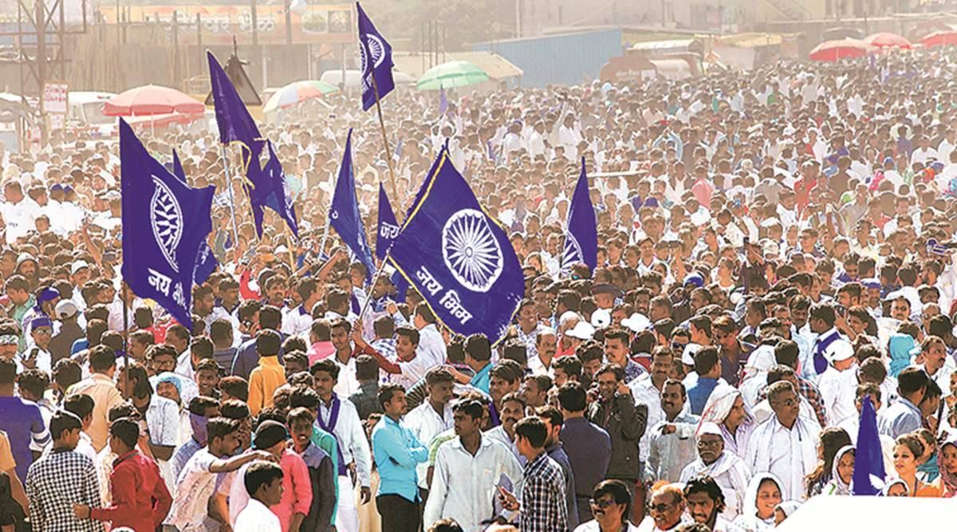
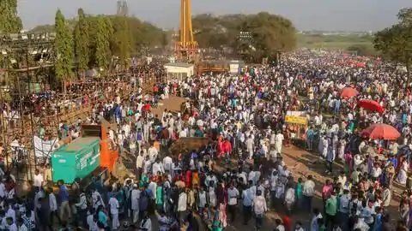
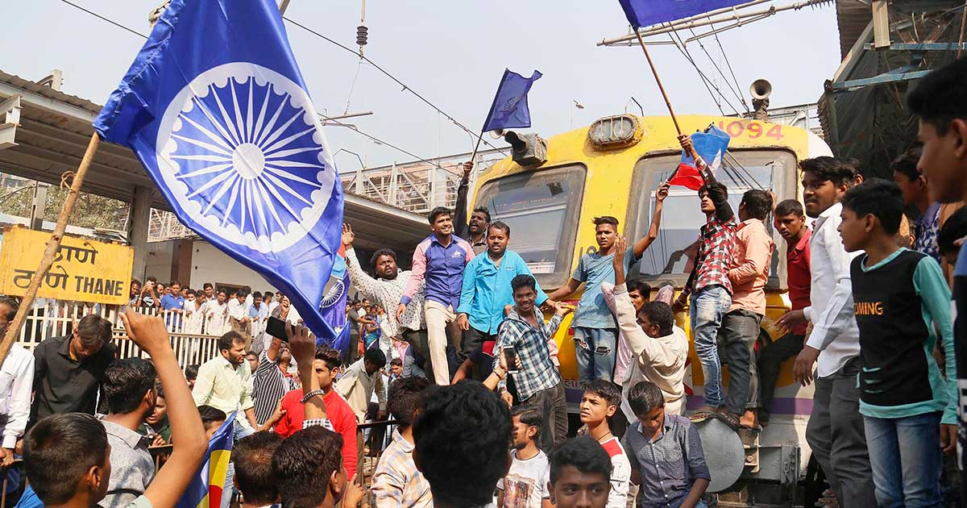
In 2020, once the case was handed over to the NIA.
A 10,000 page chargesheet naming people and connections was released.
On January 22 2020, the newly elected Maharashtra government ordered a Special Investigation Team (SIT).
On January 25 2020, the NIA, a central agency governed by the Union Ministry of Home Affairs, took over the case from the Maharashtra government.
In October 2020, the NIA released a 10,000 page chargesheet regarding the incident with fresh names.

Slide 8
Thank You

